Slide 1

CSE 470/598 Test Review
Ross Maciejewski
rmacieje@asu.edu

Slide 2
Disclaimer
These slides can only be used as study material for the class 470 at ASU
The slides cannot be distributed or used for another purpose

Slide 3
Midterm
Thursday
09:00AM – 10:15AM (sharp)
BYAC 150(this room)
20% of final grade!
Make-up exams - Only for unforeseen circumstances (proof!)

Slide 4
Grades
Projects: 55%
Midterm: 20%
Final exam: 25%
Participation: up to -20% for lack of attendance, lack of participation, or disrupting the class (for severe cases only)

Slide 5
Academic Honesty
Conform to ASU’s policy on academic honesty
Examples (non-exhaustive):
Sharing results or information during exams
Bringing forbidden material or devices to an exam
Working on an exam after official time limit
Penalty
Minimum – zero for assignment
Probable – failing grade for course

Slide 6
Materials Covered
Lecture slides give an indication
All available from Blackboard Vista site
Not all material covered during lectures (for example what you did in your homework)!
Will review some here
Good idea to
Review quizzes
Review linear algebra

Slide 7
Major Topics
Linear Algebra
Translation, rotation, scaling
OpenGL
Camera, Modelview Matrix, Projection Matrix
Light Models and properties
Mesh creation and properties
How to create a mesh
Mesh normals

Slide 8
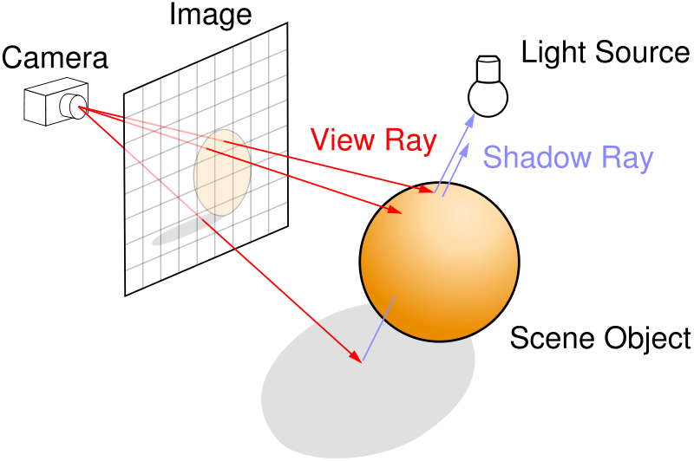

Slide 9


Slide 10
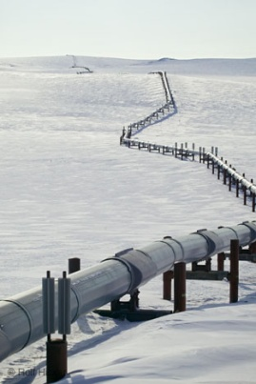
Practical Approach
Process objects one at a time in the order they are generated
Can consider only local lighting
Pipeline architecture
All steps can be implemented in hardware on the graphics card
display

Slide 11
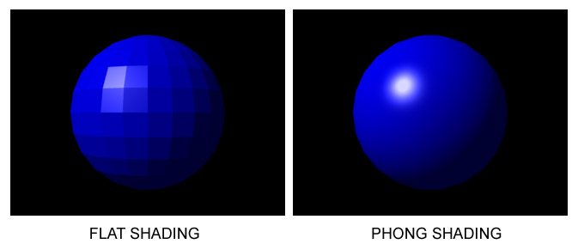
Fragment Colors
GOURAUD SHADING
LAMBERT SHADING

Slide 12
Geometry
Need three basic elements in geometry
Scalars, Vectors, Points
Scalars can be defined as members of sets which can be combined by two operations (addition and multiplication) obeying some fundamental axioms (associativity, commutivity, inverses)
Examples: the real and complex number systems under ordinary rules
Scalars alone have no geometric properties

Slide 13
Linear Vector Spaces
Mathematical system for manipulating vectors
Operations
Scalar-vector multiplication u = αv
Vector-vector addition: w = u + v
Expressions such as
v = u + 2w - 3r Make sense in a vector space

Slide 14
Homogeneous Coordinates
The homogeneous coordinates form for a three-dimensional point [x y z] is given as
p =[x’ y’ z’ w] ^{T} =[wx wy wz w] ^{T}
We return to a three dimensional point (for w ≠ 0) by
x ← x’/ w
y ← y’/ w
z ← z’/ w
If w = 0, the representation is that of a vector
Note that homogeneous coordinates replaces points in three dimensions by lines through the origin in four dimensions
For w = 1, the representation of a point is [x y z 1]

Slide 15
Translations
Can be used to express a translation using a 4 x 4 matrix T in homogeneous coordinates
p’=Tp where
T = T(d_{x}, d_{y}, d_{z}) =
This form is better for implementation because all affine transformations can be expressed this way and multiple transformations can be concatenated together

Slide 16
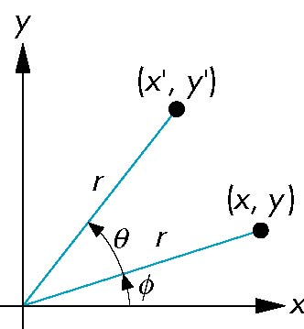
Rotations
Consider rotation about the origin by θ degrees
radius stays the same, angle increases by θ
x’ = r cos (φ + θ)
y’ = r sin (φ + θ)
x’ = x cos θ –y sin θ
y’ = x sin θ + y cos θ
x = r cos φ
y = r sin φ
Notes:
Cos(x + y) = cos x cos y – sin x sin y
Sin(x + y) = sin x cos y + cos x sin y

Slide 17
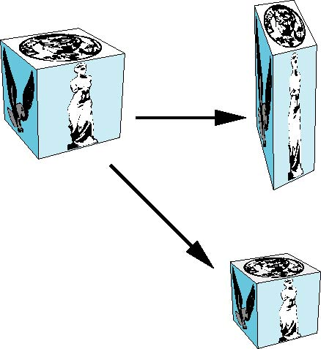
Scalings
Expand or contract along each axis (fixed point of origin)
x’ = s_{x} x
y’ = s_{y} y
z’ = s_{z} z
p’=Sp
S = S(s_{x}, s_{y}, s_{z}) =

Slide 18
OpenGL is a State Machine!
Stores internal state
Color, transformation, line width, point size…
Two types of operations
Change state
Draw primitives
Metaphor: artist’s kit (palette, canvas, paintbrushes)
Color
Brush size
Position on canvas

Slide 19
OpenGL Primitives
GL_POINTS
GL_POLYGON
GL_LINES
GL_LINE_STRIP
GL_LINE_LOOP
GL_TRIANGLES
GL_QUAD_STRIP
GL_TRIANGLE_STRIP
GL_TRIANGLE_FAN

Slide 20
Polygon Issues
OpenGL will only display polygons correctly that are
Simple: edges cannot cross
Convex: All points on line segment between two points in a polygon are also in the polygon
Flat: all vertices are in the same plane
User program can check if above true
OpenGL will produce output if these conditions are violated but it may not be what is desired
Triangles satisfy all conditions
nonconvex polygon
nonsimple polygon

Slide 21
Taxonomy of Planar Geometric Projections
planar geometric projections
parallel
perspective
1 point
2 point
3 point
multiview
orthographic
axonometric
oblique
isometric
dimetric
trimetric

Slide 22
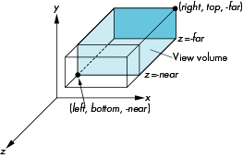
OpenGL Orthogonal Viewing
glOrtho(left,right,bottom,top,near,far)
near and far measured from camera

Slide 23
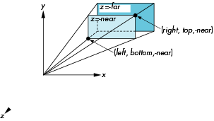
OpenGL Perspective
glFrustum(left,right,bottom,top,near,far)

Slide 24
View Normalization
Rather than derive a different projection matrix for each type of projection
Convert all projections to orthogonal projections with the default view volume
Known as view normalization
This strategy allows us to use standard transformations in the pipeline and makes for efficient clipping

Slide 25
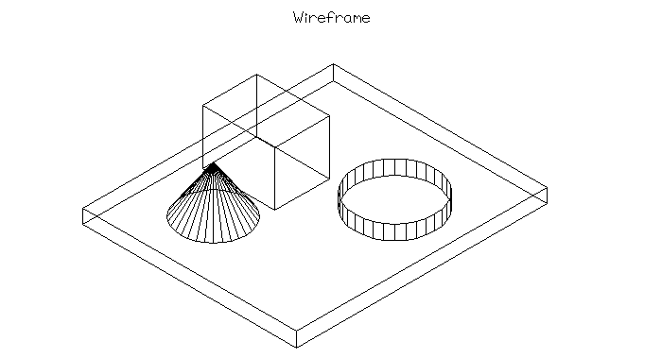
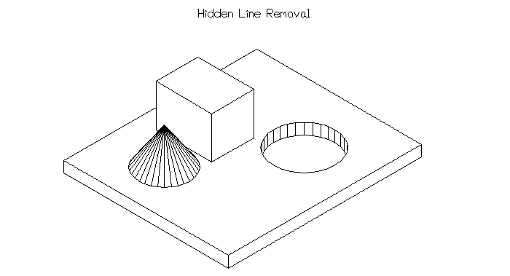
Hidden Surface Removal

Slide 26
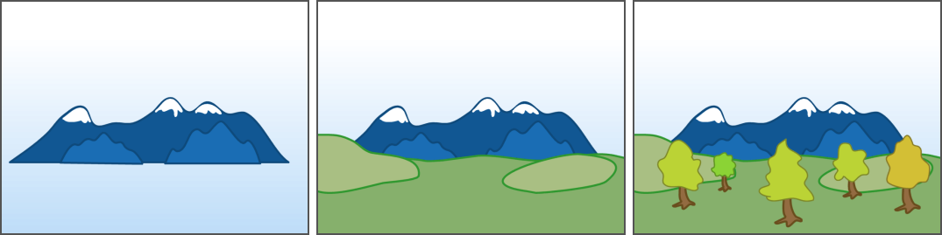
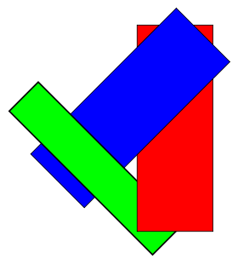
Painter’s Algorithm

Slide 27
Z-Buffer
Calculate depth information per pixel
We know depth for each
Can interpolate
Add a depth buffer to the frame buffer
Initialized to max depth
When drawing a color pixel in frame buffer
Check if existing pixel is closer
If it is closer, discard new pixel
It is further away, draw pixel and update z-buffer

Slide 28
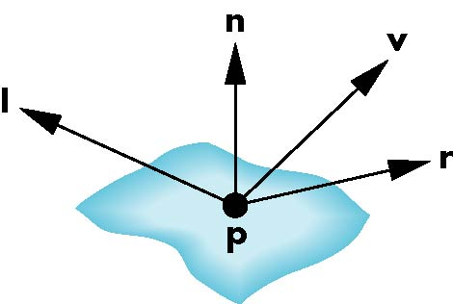
Phong Model
A simple model that can be computed rapidly
Has three components
Diffuse
Specular
Ambient
Uses four vectors
To source
To viewer
Normal
Perfect reflector

Slide 29
Light Equation
OpenGL light computation
Light intensity I computed for each color component (R, G, B)
3D-vector (but not for x, y, z)
I = I_{D} + I_{S} + I_{A}

Slide 30
Lambertian Surface
Perfectly diffuse reflector
Light scattered equally in all directions
Amount of light reflected is proportional to the vertical component of incoming light
reflected light ~cos θ_{i}
cos θ_{i} = l · n if vectors normalized
There are also three coefficients, k_{r}, k_{b}, k_{g} that show how much of each color component is reflected

Slide 31
Modeling Specular Relections
Phong proposed using a term that dropped off as the angle between the viewer and the ideal reflection increased
I_{r} ~ k_{s} I cos^{α}φ
φ
reflected
intensity
shininess coef
incoming intensity
absorption coef

Slide 32
Defining a Point Light Source
For each light source, we can set an RGBA for the diffuse, specular, and ambient components, and for the position
GL float diffuse0[]={1.0, 0.0, 0.0, 1.0};
GL float ambient0[]={1.0, 0.0, 0.0, 1.0};
GL float specular0[]={1.0, 0.0, 0.0, 1.0};
Glfloat light0_pos[]={1.0, 2.0, 3,0, 1.0};
glEnable(GL_LIGHTING);
glEnable(GL_LIGHT0);
glLightv(GL_LIGHT0, GL_POSITION, light0_pos);
glLightv(GL_LIGHT0, GL_AMBIENT, ambient0);
glLightv(GL_LIGHT0, GL_DIFFUSE, diffuse0);
glLightv(GL_LIGHT0, GL_SPECULAR, specular0);

Slide 33
Material Properties
Material properties are also part of the OpenGL state and match the terms in the modified Phong model
Set by glMaterialv()
GLfloat ambient[] = {0.2, 0.2, 0.2, 1.0};
GLfloat diffuse[] = {1.0, 0.8, 0.0, 1.0};
GLfloat specular[] = {1.0, 1.0, 1.0, 1.0};
GLfloat shine = 100.0
glMaterialf(GL_FRONT, GL_AMBIENT, ambient);
glMaterialf(GL_FRONT, GL_DIFFUSE, diffuse);
glMaterialf(GL_FRONT, GL_SPECULAR, specular);
glMaterialf(GL_FRONT, GL_SHININESS, shine);

Slide 34
Gouraud and Phong Shading
Gouraud Shading
Find average normal at each vertex (vertex normals)
Apply modified Phong model at each vertex
Interpolate vertex shades across each polygon
Phong shading
Find vertex normals
Interpolate vertex normals across edges
Interpolate edge normals across polygon
Apply modified Phong model at each fragment

Slide 35
Vertex Lists
Put the geometry in an array
Use pointers from the vertices into this array
Introduce a polygon list
x₁ y₁ z₁
x₂ y₂ z₂
x₃ y₃ z₃
x₄ y₄ z₄
x₅ y₅ z_{5.}
x₆ y₆ z₆
x₇ y₇ z₇
x₈ y₈ z₈
v₁
v₇
v₆
P1
P2
P3
P4
P5
v₈
v₅
v₆
topology
geometry

Slide 36
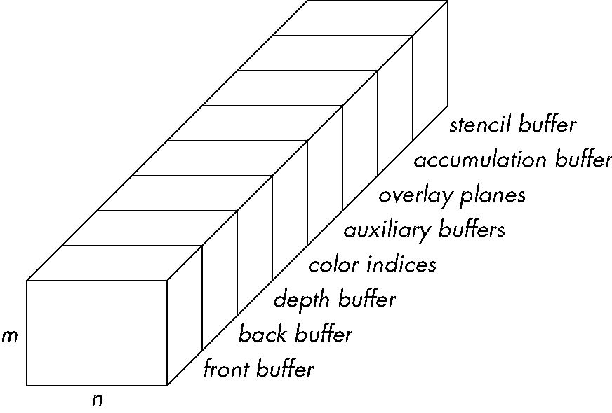
OpenGL Frame Buffer

Slide 37
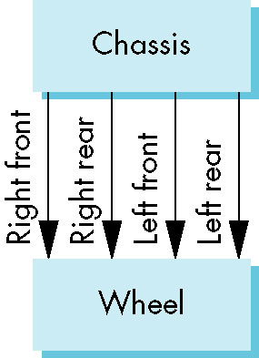
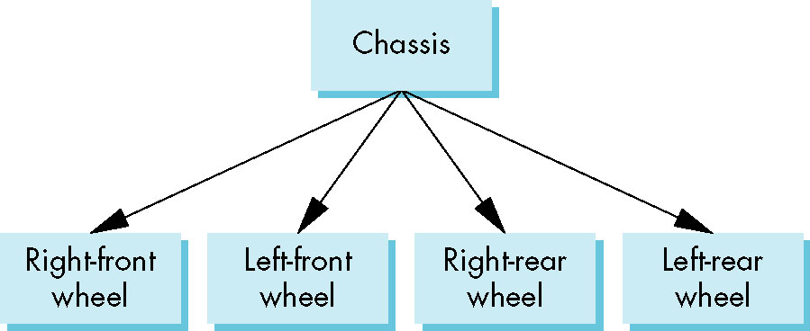
Model of a Car

Slide 38
Questions?

